Slide 1
Code Graph Explorer
Collaborative Code Visualization Platform
Notes:
Introduce Code Graph Explorer: a collaborative platform to visualize and explore code structure.
State value: faster onboarding, easier debugging, better team collaboration.

Slide 2
Team Members
Pierre Lionnel Obiang
Ryota Higa
Jerome Tran
Notes:
Present the team: Pierre Lionnel Obiang, Ryota Higa, Jerome Tran.
Briefly mention shared vision and collaboration culture.

Slide 3
Project Overview
Interactive visualization of project code structure
Real-time collaboration using WebSockets
React frontend + Django backend
Notes:
Summarize the MVP concept: interactive graph of codebase + real-time collaboration.
Tech stack: React frontend, Django backend, WebSockets.

Slide 4
Core Features
Live working collaboration
Interactive graph rendering of code
Realtime audio call integration
Save & Load functionality
Shareable workspace
Notes:
Walk through core features: live sessions, interactive graphs, audio call, save/load, sharing.
Emphasize what is live and stable today.

Slide 5
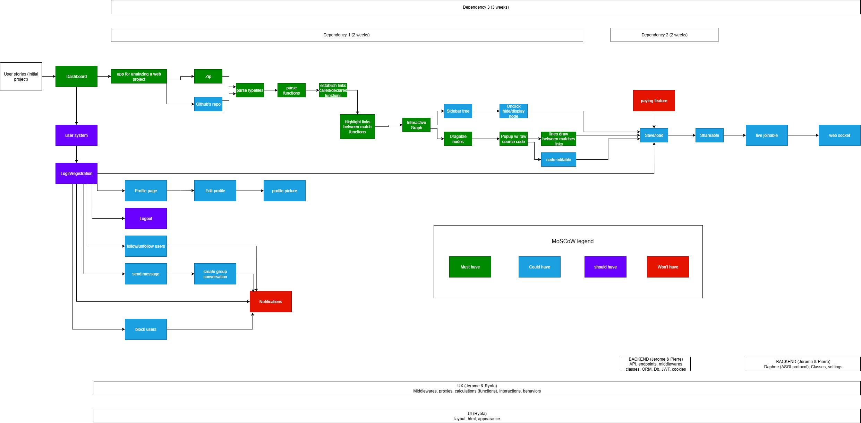
Notes:
Show architecture diagrams—explain data flow from Django to WebSocket layer to React UI.
Highlight decisions that enabled low-latency collaboration.

Slide 6
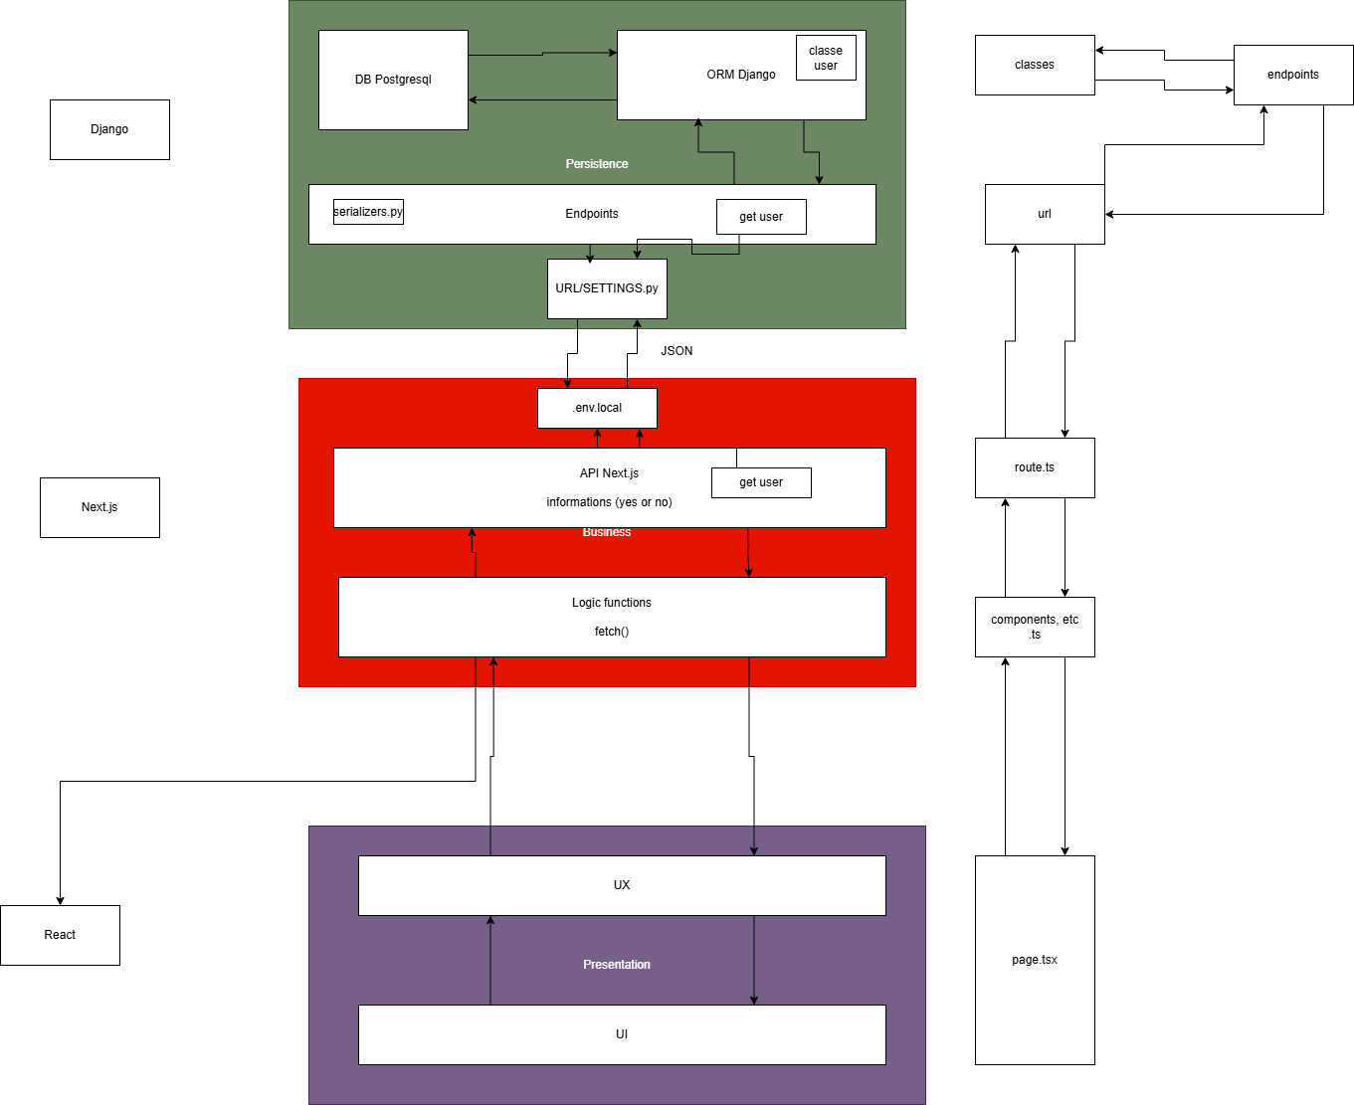
portfollio_stage_4-Page-2.drawio.png
Notes:
Automated E2E tests validate critical API paths.
Report 80% MVP completion; core live features working in practice.

Slide 7
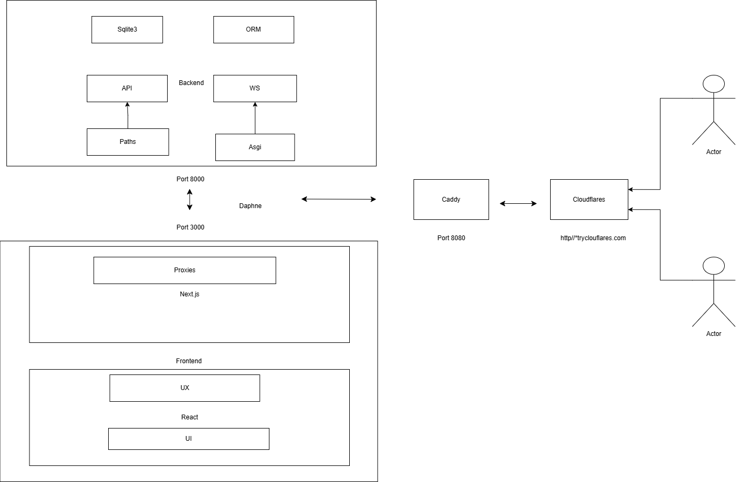
portfollio_stage_4-Page-3.drawio.png
Notes:
Lessons learned: communication, iterative prototyping, real-time complexity handling.
Note areas for future improvement (testing earlier, polish time).

Slide 8
Testing & Results
Automated E2E testing integrated
~80% MVP completion
Live features fully functional
Notes:
Roadmap: GitHub/Google integrations, payments, notifications.
Invite contributors and users to provide feedback.

Slide 9
Lessons Learned
Great team communication & alignment
Enhanced understanding of full-stack real-time systems
Graph rendering challenges solved step by step
Notes:
Thank the audience and open Q&A.
Offer to show specific flows again if needed.

Slide 10
Future Enhancements
GitHub & Google integration
Payment subscriptions
Notifications & UX improvements

Slide 11
Thank You!
Questions?

